Slide 1
International Student House
To find a cheaper and quality place to live in the UK

Slide 2
Market Research – Long term rent
Accommodation cost for a master student studying in the UK.
A double bed ensuit in student accommodation for 51 weeks is
£135*51=£6885
A double bed ensuit in house for 51 weeks is
£95 (maximum price)*51=£4845
You can save £2040 per year (more than a 6 week pre-session English course tuition fee).

Slide 3
Market Research - Long term rent
Summary of the questionnaire (Appendix One)
7 out of 9 students would like to live in private house.
Among 7 ipeople who would like to live in private house, only 2 people chose private house.
The major reasons are they don’t have access to UK house renting information, they have safe and security concern about living at private house and there s no platform to secure the payment transaction.

Slide 4
Market Research – Summer Short term rent
Summary of the research in Appendix Two
There is only one student accommodation available for summer short term rent. Price is fixed £125 per week. Only single bed ensuit available.
The average short term in House is £80 per week. There are many choices. Students can choose 2 rooms apartments or even homestay with English people.
Savings
For 6 weeks English session: (125-80)*6=£270 (equals to one month food shopping)
For 10 weeks English session: (125-80)*10=£450 (equals to a single flight ticket)

Slide 5
Market Research – September Short term
Master students have to find one month short-term lets to finish their study from 1 September to 30 September.
No student accommodation can offer short term during this time. There is almost no landlord will offer one-month rent.
Living in hotels for a month will cost about £1500.
There is no business providing affordable monthly rental price for international students.

Slide 6
Competitors research
Chinese agent can not provide reliable house renting services. They are not based in the UK. They can’t provide instant service if students have disputes or problems with landlords.
UK agents which are most likely local based. Their target customers are local rather than international.

Slide 7
Marketing plan
Product/Service
Long term rent for undergraduate and postgraduate students
The properties we advised will meet the standards set up by Liverpool Student Home (LSH).
All our house for rent will be approved by LSH. I am having discussion with LSH with partnership work.
The website will provide service specialising for international students.
Summer Short term rent for pre-sessional English course students
There will be different types of housing. Student can do homestay or live with English people or live with their friends.
They will have cheaper but reliable source of accommodation.
September Short term rent for student doing master degree
Have long term relationship with providers who can provide short term rent during September every year.
Future Development
Short term (30 days) study visit (mature students from china on visiting visa)

Slide 8
Marketing plan
Price
Long term let
Price is decided by individual landlords. Price will start from £60 per week.
Summer short term let
Price starts from £80 per week.
September short term let
Price will be more expensive than normal weekly rent but cheaper than hotel
Average price –
£120 per week for house
£200 per week for apartment

Slide 9
Marketing plan
Promotion
Word of Mouth – recommendation
Social Media – wechat , Chinese student forum
Website – regular updates & featured house
Agents in China – recommend the website to students who are coming to UK to study.

Slide 10
Marketing plan
People
I will be responsible to all aspects of the business as a sole trader. I will pay for the IT service e.g. website developing and maintenance on a consultancy basis. As the business develops I will take on additional staff to support customer service.
Place
I will be operating the business from home initially. I am looking to have a virtual office service at Women’s organisation or have a hot desk provided by Uni.

Slide 11
Finance plan
Start up cost
Laptop, printer
Website development
Business insurance
Advertising
Legal service fee
Please see 2017 (12 month) cashflow forecast

Slide 12
Projected sales for 2017
 | No. of tenants | No. of landlords | Price | Turnover
Summer short term let | 20 | 4 | 50 | 20*50+4*50=£1200
September short term let | 30 | - | 50 | 30*50=£1500
Long term let | 30 | 6 | 200 , 100 | 30*200+6*100=£6600
Visitors studying short term course | 10 | 2 | 200 , 100 | 10*200+2*100=£2200
Total | 90 | 12 | - | £11,500
*Scale of students – Chinese students studying at Liverpool Universities.

Slide 13
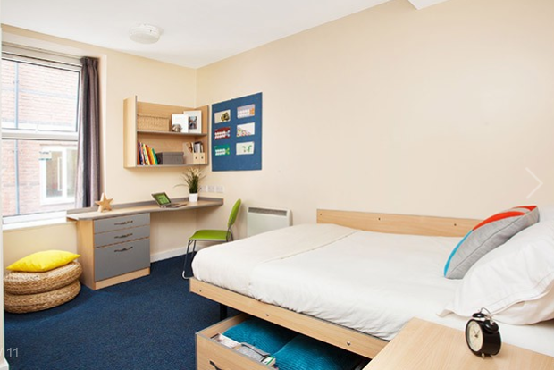




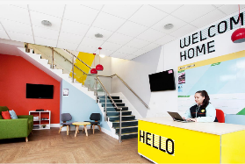

Example of website – property description
4.5
Education background, subject, years of renting
Safety
Distance
Maintenance
Service
Customer review
It is a great place to live!

Slide 14
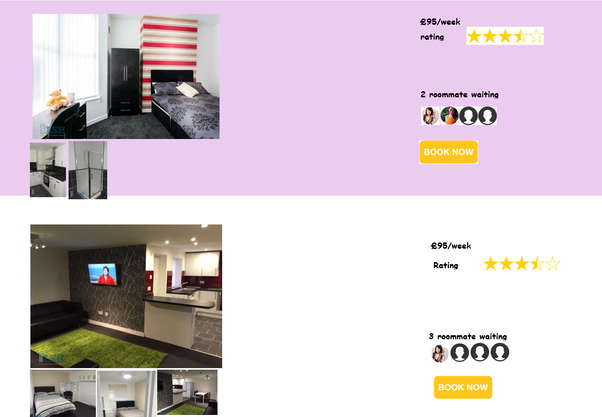
Example of website – finding roommates

Slide 15



Future development – study one month course during travelling the UK
From 1 Oct 2013, visitor visa holder can study up to 30 days course. Courses can be sailing, kayaking training, the British court costumes tailor training, sports motorcycle driver’s license training, photography and other lifestyle courses. This suits Chinese professionals who wants to learn advanced skills which might not be original in China.
No relevant data shows how many people take one month course during their visit. However, there is about 150 million Chinese coming to visit UK in 2015. which increases about 74% number of visitors than 2014.
There is no company provide courses information as well as reliable source of accommodation for a month.

Slide 16
Appendix One - Questionnaire ：Do you prefer living at Student Accommodation or Houses in your first year? Why?
9 Master Students | Gender | Where did you live in your first year | Reason | Would you like to live in Private House | Reason | Reason for not choose house as your first choice
东哥 | Male | Student Accommodation | Internet Agent | Yes | Same as student accommodation Cheaper price | Don’t have information about house Don’t trust private landlords Potential Disputes
适 | Male | Private House | Friend Recommendation | Yes | Same as student accommodation Cheaper price | x
Rolando （Mexico） | Male | Student Accommodation | Internet Agent | Yes | Same as student accommodation Cheaper price | Don’t have information about house Don’t trust private landlords Payment security
Jules （Congo） | Male | Student Accommodation | Internet Agent | Yes | Same as student accommodation Cheaper price | Don’t have information about house Don’t know who is going to live with
张记 | Male | Private House | Friend Recommendation | Yes | Cheaper price | x
Project Man A （Nigeria） | Male | Student Accommodation | Internet Agent | Yes | More relax Cheaper price | Don’t have information about house Payment security
临 | Female | Student Accommodation | Internet Agent | No | Don’t need to share bathroom | x
茹 | Female | Student Accommodation | Internet Agent | No | Have security guard Safer | x
玉菡 | Female | Student Accommodation | Internet Agent | Yes | Cheaper | Don’t have information about house Don’t know who is going to live with

Slide 17
Appendix Two
Pre-sessional English | Course dates | Fee
10 weeks | 04/07/16 - 09/09/16 | £2,900
6 weeks | 01/08/16 - 09/09/16 | £1,740
Student accommodation available for summer short term
Main Student Accommodation | No. of room available | Price per week
University Accommodation | No Reponses on telephone | -
United Student Accommodation | Only available till 2nd September | -
Liberty Park | About 200 rooms | £125 (single bed ensuit)
Hope Street Apartment | 3 rooms | £121.50
X1 | No | -
The market research is done on 19/07/2016

